Slide 1
ANNUAL
REPORT
2021

Slide 2
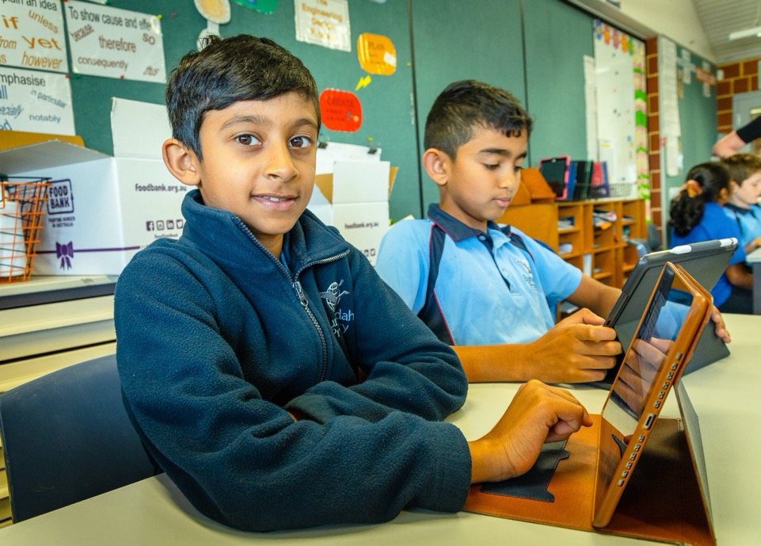
Message from the Principal 3
Message from the Chair of the School Board 4
Student Enrolment 5
Engaging Our Community 9
Curriculum and Learning Initiatives 14
School and Student Achievement 32
Financial Reporting at 31 December 2021 37
Contents

Slide 3
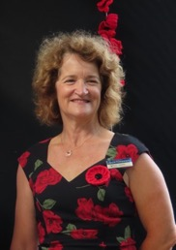
Message from the
Principal
Janine Kinninment
Welcome to the Burrendah Primary School Annual Report. This report describes the schools achievements, activities and growth as a school community during the 2021 school year.
Burrendah Primary School continued to provide quality education to our students despite the restrictions of the pandemic. Our school was recognised as being a school of distinction in the WA Primary School Education Awards 2021, being selected as a finalist, an outstanding outcome. Our continued successes are a result of the combined hard work and commitment of the students, parents, staff and our wider community.
It was pleasing to see many COVID restrictions lifted as the year progressed. This enabled a number of school events to occur such as open classrooms, assemblies, graduation, evening music celebrations and EduDance concerts.
I would like to recognise the continued leadership of Board Chair, Brad Warburton. His knowledge and expertise, based on his close association of state COVID-19 procedures, enabled Burrendah Primary School to effectively work within the restrictions.
Our school received substantial state funding for a new undercover area. This build includes a general classroom, office and sports storeroom. The 1.7-million-dollar undercover area will commence mid-2022.
Burrendah Primary School received a certificate for Recognition of Academic Excellence 2021 for NAPLAN in reading, writing, and numeracy from the Minister, Sue Ellery, and Director General, Lisa Rogers. Burrendah Primary School staff are to be commended and acknowledged for this excellent result through their continued focus and efforts on supporting the best possible outcomes for our students.
A number of long serving staff retired in 2021. With a total of 74 years at Burrendah Primary School and 157 years in Education, I thank the following outstanding staff for their dedication to education, and in particular to Burrendah students; Mrs Sue Horoch, Mrs Helen Elston, Mrs Kerry McCubbin and Mrs Vivienne Nicholas.
2021 signalled the final year of our 2019-2021 Business Plan. Work is in progress for our next business plan which will be finalised in 2022.

Slide 4
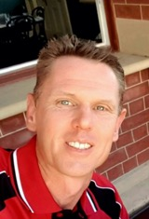
Message from the
Chair of the School Board
Brad Warburton
It is with great pleasure that I present the 2021 Burrendah School Annual Report on behalf of the Board.
I wish to acknowledge my fellow Board members, consisting of volunteer staff, parents, community members, and Burrendah leadership representatives, for their remarkable efforts in continuing to overcome the many challenges experienced during the two years of the COVID-19 pandemic.
Throughout 2021 the Burrendah Board focused on effective communication to all areas of our school and the broader community. Our commitment, premised on consultation and collaboration, proved successful, with increased parent and community members on our Board reflecting our community's many cultural and diverse groups.
As a finalist in the 2021 WA Primary School of the Year, Burrendah Primary School maintained its reputation as a high performing school that excels in creating a culture of success and learning and focuses on empowering students to achieve their potential.
In my professional employment, I continued to be at the forefront of COVID-19 operations to implement COVID policy and operational practices on a large scale. My insight of applying best practices for managing COVID highlighted the commitment and professional work of the Burrendah leadership team and staff to align the schools' approaches to ensure a safe environment for our school community.
In 2021 the Burrendah leadership team, staff and Board successfully re-united the school community post-Covid. Introduced remote learning platforms, consistent and regular communications while reflecting on where we can improve, ensured our school continues to connect, collaborate and commit to develop the interests of the Burrendah Primary School community.
I wish to thank the outgoing Board members: Mr Henry Lam (Parent representative) and Mrs Sue Horoch (Deputy Principal); thank you both for your commitment and contribution to Burrendah Primary School.
Further acknowledgement to Mrs Sue Horoch, retiring after 45 years of diligent service to education; we wish Sue a happy retirement and thank her for her passion and commitment to Burrendah Primary School.
With new Board members coming on in 2022, I look forward to the board guiding and supporting exciting new initiatives that enhance student outcomes and promote Burrendah Primary School being a remarkable Independent Public School.

Slide 5
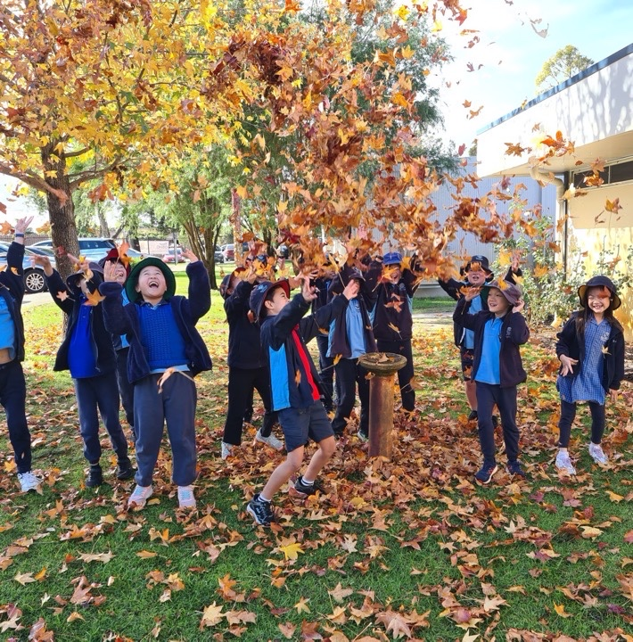
Student Enrolment
Enrolment
Student enrolment numbers from Kindergarten to Year 6 increased slightly from 668 at Census to 677 students over the course of 2021. Students, including siblings, are required to reside in our local intake area to be guaranteed a placement at Burrendah Primary School.
In 2022 we will move to a 25 classroom structure.
Attendance
Despite the pandemic we have maintained our high attendance results.
The attendance at Burrendah Primary School continues to be above WA Public Schools in all year levels.

Slide 6
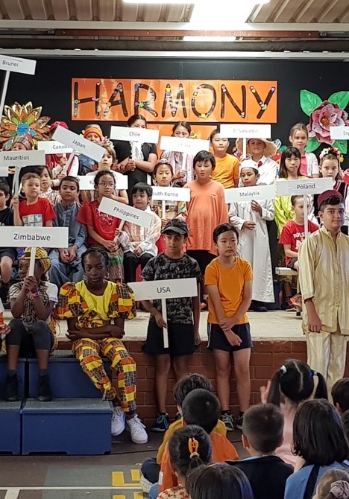
Our Diverse Community
Our Students Considering there has been very little immigration to Australia in the past two years, it is interesting to note that 65% of our students have a language background other than English, speaking 44 different languages. An increasing number of our EAL/D students are born in Australia but speak a language other than English at home. These students need support in their first few years at school but tend to thrive as they progress through the school.
EAL/D Support In 2021 the EAL/D team directly supported 110 students with 86 of these receiving EAL/D reports using Progress Maps. Language support is given to eligible students from Pre-Primary to Year 6. A select number of Stage 3 (non-eligible) students in Year 3 and Year 4 continued to receive support throughout the 2021 school year. Our Mandarin speaking Ethnic Educational Assistants (EEA) provided support to our Kindergarten students during their language transition from home to school, particularly at the start of the year. Our three part time EEAs continued to be of great value in assisting with parent/teacher interviews and on-going teacher communication with families.
EAL/D teachers and education assistants work with students in class or in small groups. We also provide individual reading support to several students to ensure that their reading is listened to at least once a week.

Slide 7
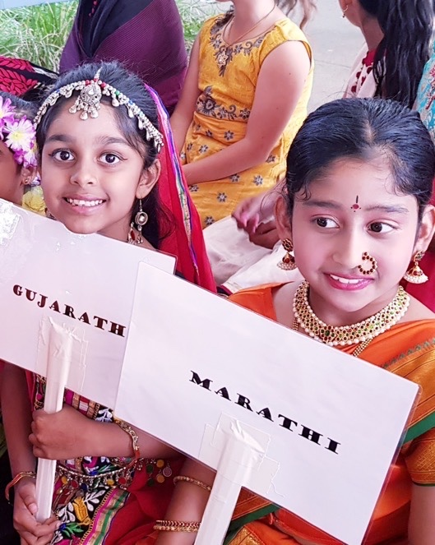
Our Diverse Community – cont.
School Cultural Celebrations
Our school celebrations were a feature of the 2021 school year as there were no class assemblies and coming together as a school was really a cause for celebration. The EAL/D Team, in cooperation with Ms Coleman, ran a vibrant Harmony Day Assembly with the school leaders hosting the event. Once again, our diversity shone through with most of our students and staff wearing traditional dress or the colour orange to celebrate the occasion. Members of the HASS Committee, led by Mrs Taylor and our Music Specialist, Ms Coleman, worked with the EAL/D Team to produce the NAIDOC Assembly, addressing the 2021 theme of “Heal Country.” We were honoured to have Dr Richard Walley and his son Alton open the assembly.
Thanks to Mrs Sesetti’s lunchtime dance lessons, we celebrated Diwali with a couple of vibrant dance performances. Teachers joined students and parents in the celebration by dressing up in traditional clothes with the help and generosity of our parents. All three celebrations involved students from a range of classes making these multi-aged performances a joy to watch.
Culture Club
Culture Club started up again in Term 2 after not being able to run in 2020 due to Covid-19 restrictions. We had wonderful Burmese parents start us off with Culture Club Myanmar, followed by very enthusiastic parents to run Culture Club Taiwan and Culture Club Indonesia.

Slide 8
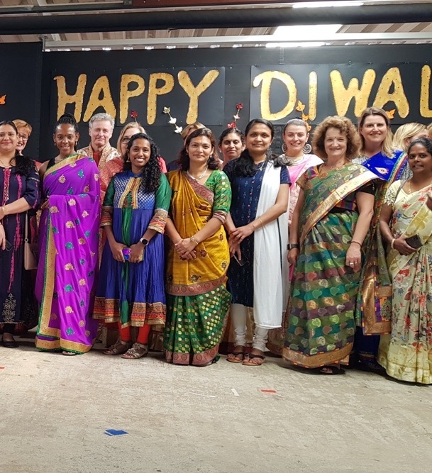
Our Diverse Community – cont.
Parent Network Group
After a hiatus of 18 months, we invited parents to attend the EAL/D Parent Network group in Term 2 and continued to have sessions in Term 3 and 4. Our aim is to rebuild attendance of this network to pre-pandemic days.
Multicultural Community Links
As Burrendah Primary School often invites members of the wider community into our school, it is also important that we participate in cultural programs outside the school.
In 2021 Ms Coleman taught all our students to sing a Filipino song, “Bahay Kubo”. We recorded the choir singing this song and it was shown on screen at the 75th Anniversary of Australian and Filipino Diplomatic relations at Langley Park in May 2021.
Sister Kate’s notable artist, Aunty Alta Winmar worked with 15 of our artistic students on a City of Canning project for the new Hillview Intercultural Centre in Bentley. Their artistic contribution is on a large mural and on four doors at the centre. These are permanent installations for the first intercultural centre south of the river.

Slide 9
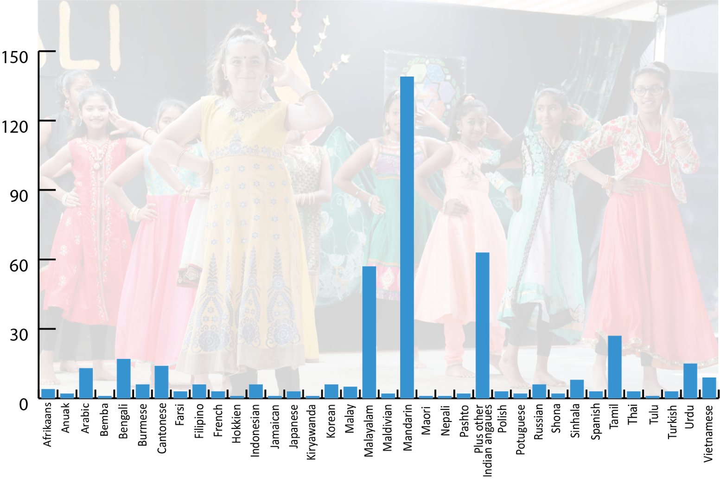
LANGUAGE BACKGROUND (OTHER THAN ENGLISH. TOTAL 439 STUDENTS)
Our Diverse Community – cont.
We have a very culturally diverse community, with over 44 languages other than English, spoken by our students. Our supportive and welcoming learning environment recognises and celebrates this diversity.
NUMBER OF STUDENTS
* Marathi, Gujarati, Punjabi, Konkani, Kannada, Telugu, Hindi, Tulu, Oriya
*

Slide 10
Engaging our Community
School Board – Providing Excellent Governance
The Burrendah School Board continued to work effectively as the peak decision making body of the school.
Business Plan targets were monitored following presentations to the Board throughout the year. These presentations were conducted by students and staff on school wide testing and new whole school initiatives.
“Increasing the number of nominations for positions on the School Board” is a business plan target. While positions were filled for parents and staff on the Board, nominations did not exceed the number of positions. Pleasingly we increased the number of Community Representatives on the Board.
The Board Chair and a P&C representative attended the Student Leaders Forum in Perth with our student leaders.
The Board nominated Burrendah Primary School for WA Primary School of the Year 2021. Burrendah Primary School was selected as one of the top four schools in WA and was named as one of the finalists for this prestigious awards.
A key focus in 2022 will be developing the next 3-year business plan. A number of members on the Board are on the School Review Committee which is driving the planning for the 2022-2024 Business Plan.

Slide 11
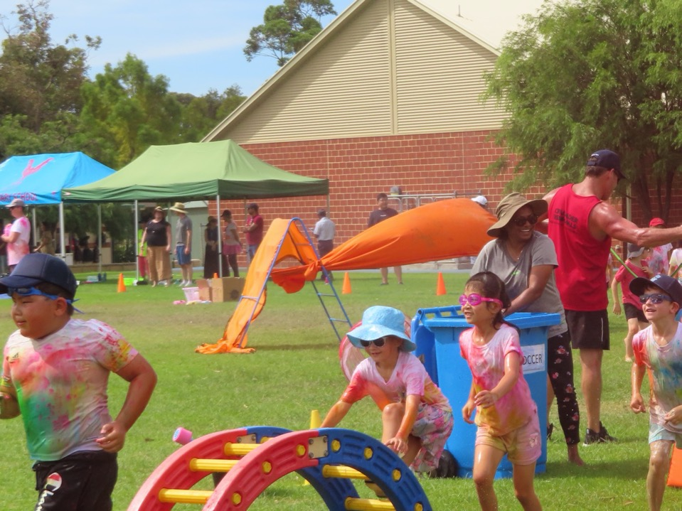
Supportive Parents and Citizen Association
The Parents and Citizens Association (P&C) supports the education of all of our students and is keen to promote parent interaction in the school.
The P&C continued to volunteer their time to provide greatly appreciated support to the school, including fundraising to assist with projects. A focus for 2022 is to complete the first phase of a Nature Playground. Fundraising of $35 000 has been raised towards this project.
“Increasing the number of nominations for positions on the P&C” is a business plan target. While all positions were filled, nominations did not exceed the number of positions.
The P&C through the assistance of volunteers, run a pre-loved uniform shop, book club, and P&C Facebook page.
The P&C continued operating the canteen one day each week using a Willetton Senior High School (WSHS) service provider.
Events organised by the P&C included: The Colour Run, Mother’s Day, Crazy Hair Day, Quiz Night, Father’s Day, Outdoor Movie Night, Athletics cake stall, School Disco and special luncheons.
Burrendah Primary School celebrated P&C Day with a special morning tea provided by staff for the P&C, to show their appreciation of this dedicated group of parent and carers.
11

Slide 12
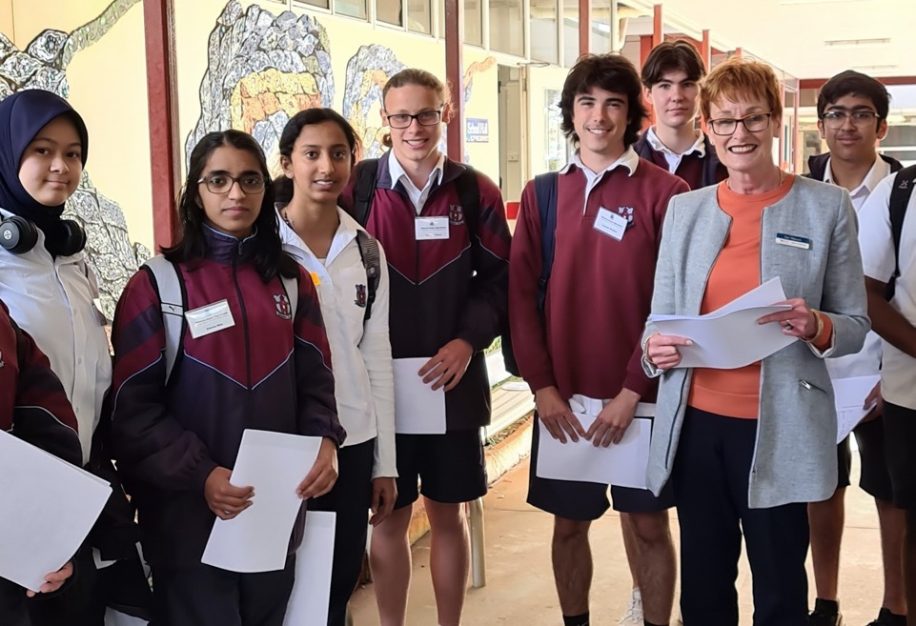
Teacher Practicums Burrendah Primary School teachers continued to provide mentoring to student teachers from a number of Universities. The student teacher practicums range from a few weeks to a full term.
A practicum student was employed at Burrendah Primary School as a Graduate teacher for 2022.
Collaboration with Willetton SHS
Willetton Senior High School (WSHS) and Burrendah Primary School continued their close working relationship with programs such as:
Year 11 and 12 students attended Burrendah Primary School to gain work experience towards their Certificate II Community Services qualifications. Throughout 2021, 500 WSHS students were a part of the Community Links Program where WSHS students assisted in classrooms for a term.
Japanese Gifted & Talented Program where identified Year 6 students attend weekly language lessons at WSHS.
Selected IMSS students attended music lessons at WSHS.

Slide 13
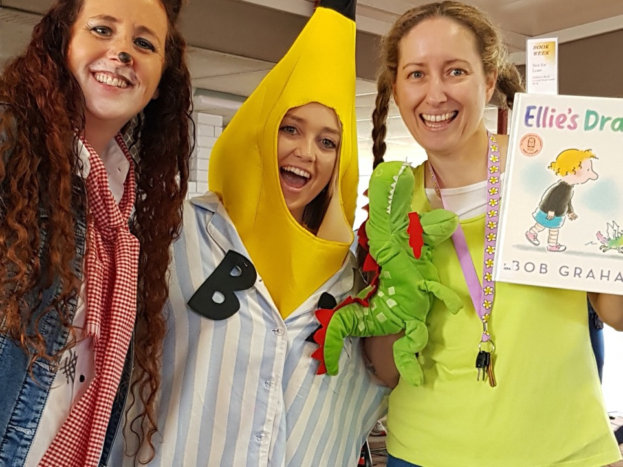
National Schools Opinion Survey Result Highlights (NSOS)
The NSOS is conducted biannually. The latest survey was conducted in 2020. The next NSOS will be conducted in 2022. Results can range from 1, strongly disagree to 5, strongly agree. In the latest survey:
Parents (4.3), staff (4.6) and students (4.5) all agree teachers expect students to do their best.
Parents (4.2) and staff (4.4) would recommend our school to others.
Parents (4.1), staff (4.6) and students (4.3) agree our school looks for ways to improve.
Parents (4.3), staff (4.1) and students (4.1) agree the school is well maintained.
Ratings such as these supported the School Board's decision to nominate for the WA Primary School of the Year Awards 2021, where Burrendah Primary School was a finalist.

Slide 14
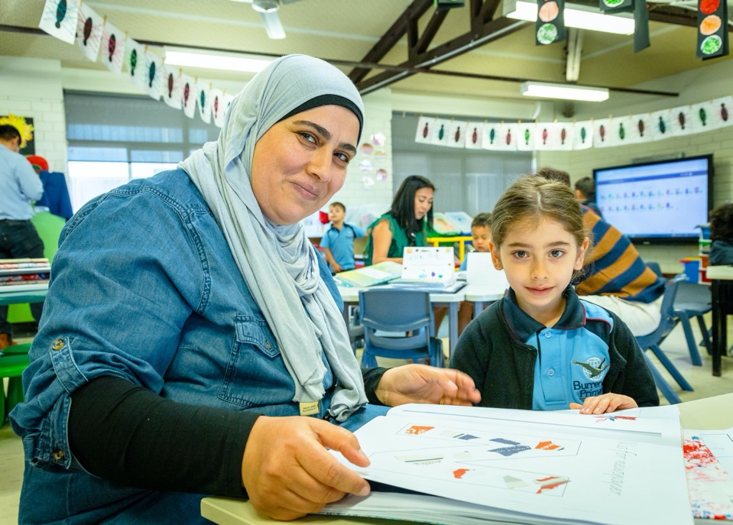
National Schools Opinion Survey Result Highlights (NSOS) cont.
As a result of this survey the following are being implemented:
A new front entrance installed at the Pinetree Gully Road entrance
Introduction of the GROW Award as a result of student feedback
Continue to seek ways to re-engage the community during and post COVID-19
Continue to seek feedback from the parent body on matters pertaining to them
Continue to seek ways to improve infrastructure of the school

Slide 15
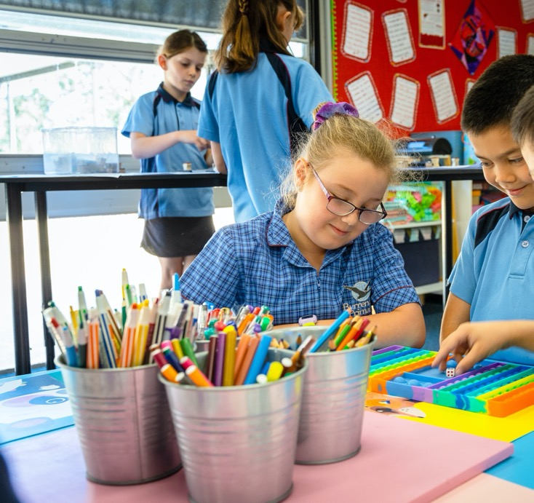
Curriculum and Learning Initiatives
Mathematics
Burrendah Primary School has established a whole school approach to Maths which aims to resolve student misconceptions, increase fluency and engage students in problem-solving skills. An evidence based approach has been incorporated into teaching Mathematics, which is providing common and consistent practices across the school.
Following on from extensive whole school professional learning involving all teachers, our Maths Operational Plan has been updated and now incorporates teaching in-line with this pedagogy.
The Maths budget last year was allocated to increasing Maths resources across the whole school. This took the form of replenishing larger items and providing Cohort boxes for each year level that contained necessary requirements for teachers to teach the curriculum. Individual number boxes in each classroom were also updated and replenished as needed. Ongoing Professional Learning is provided to teachers. A lunchtime Numero club was commenced in 2021 for senior students.
All the students in Years 1 to 6 completed the annual PATS Mathematics assessment in Term 4. All students in Years 3 and 5 completed the annual NAPLAN assessment. Brightpath Mathematics is being incorporated in some cohorts to support formative and summative assessment. PAT data shows that students at Burrendah Primary School are continuing to perform at a level above the average norm sample range as compared to other Australian schools.

Slide 16
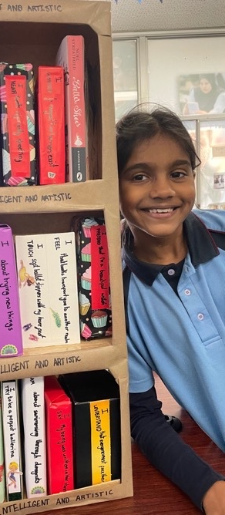
Literacy
The whole school guided reading approach is well established throughout the school. To support the reading programme in upper primary and meet the needs and interests of more able readers, 11 sets of novels comprising 121 books were purchased and put into circulation in classrooms in 2021.
Regular and systematic assessment of reading progress through PM Benchmarks and PAT testing continued to ensure that students’ reading needs are being met. Term 4, 2021 PAT Reading results for each year level Years 1 to 6 demonstrate that Burrendah Primary School continues to be consistently above norm results in Reading compared to other Australian schools.
To enhance assessment in Reading in the early years, the SPARKLE Assessment Kit was purchased in 2021. This tool measures phonics knowledge, decoding skills, text comprehension and fluency, matching students’ reading level with the suitable level of decodable text. This will help to ensure students are working on the relevant decoding skills for their stage of reading development.
To support our reading programme in the early years, 400 decodable home readers were purchased and put into circulation in junior classes. Letters and Sounds has been established as the school’s approach to teaching reading through synthetic phonics in Years Pre-Primary-Year 2.
Through this approach, students are taught the knowledge of letters and sounds and the skills of sounding and blending. Decodable home readers have allowed students to practice these skills in a sequential way that aligns closely with and supports learning in the classroom.
The ‘Seven Steps to Writing Success’ program has continued to be utilised in Year 2-Year 6, with access to the online subscription for teaching staff maintained in 2021, providing teachers with a wide range of engaging resources which are regularly updated. In Kindergarten through to Year 1, Talk for Writing continues to be implemented to support the teaching of writing. In 2022, the development of a Scope and Sequence that details the transition between these two approaches will be a priority.

Slide 17
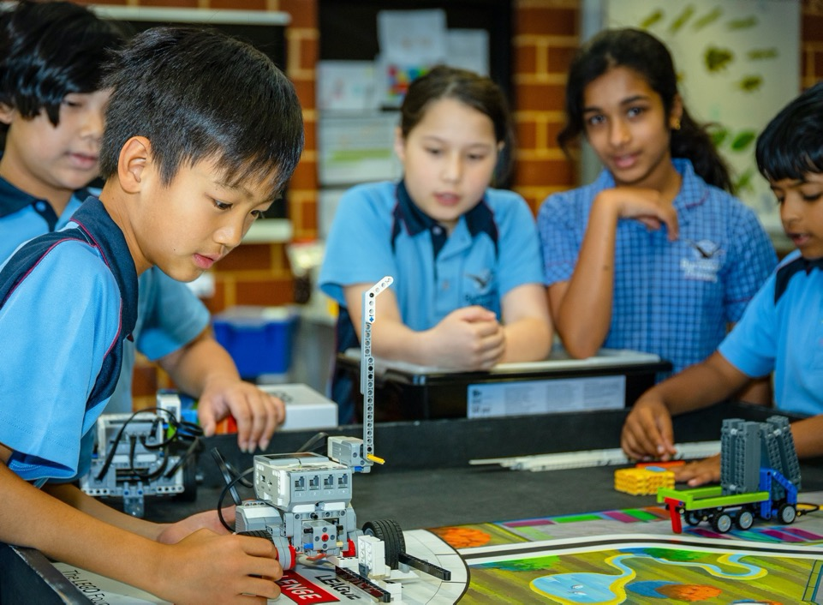
Technology
In 2021, we had a 96% uptake of our Bring Your Own Device – iPad (BYOD) program. Having this percentage of Year 4 families providing their child an iPad in the first year of implementation is very pleasing. In Term 1 & 2, Year 4 students focused on how to use the basic functions of the iPad and productivity apps, such as Pages, Number, Keynote, Garage Band, Clips and iMovie. This was followed by a more integrated approach to using iPads as an effective learning tool. At the end of the year, teachers reported a high level of student engagement and heightened student learning.
For the second year we enlisted the support of Winthrop Australia’s professional learning coach, Michelle Forrest, who trained teachers and students in the use of these devices as an effective learning tool. In Terms 1 & 2, her focus was on the Year 4 teachers as they implement iPad usage in the classroom. Then in Terms 3 & 4, Michelle Forrest worked with the Year 5 teachers so they could add value to the BYOD program in 2022.
In terms of hardware, the school has now moved away from desktops and notebooks and have purchased or leased iPads across the whole school. This has streamlined our infrastructure and provides a consistent learning platform from Kindergarten to Year 6. By 2023, our aim is that students from Year 4 – Year 6 will bring their personal iPad to school and we will continue to provide iPads on a shared basis from Kindergarten – Year 3. In addition to this, we will continue to replace our aging Interactive White Boards with up-to-date LCD screens.
Given that 2021 was our first year of the BYOD program we discovered a few technical issues which largely related to school verses home use. These issues have been now resolved along with clearer guidelines for parents.
As the demands on the school network have increased, we have been slowly up-dating our Wireless Access Points (WAP) and switches to handle a higher level of traffic. This will continue into 2022/23 as the cost to the school is considerable.

Slide 18
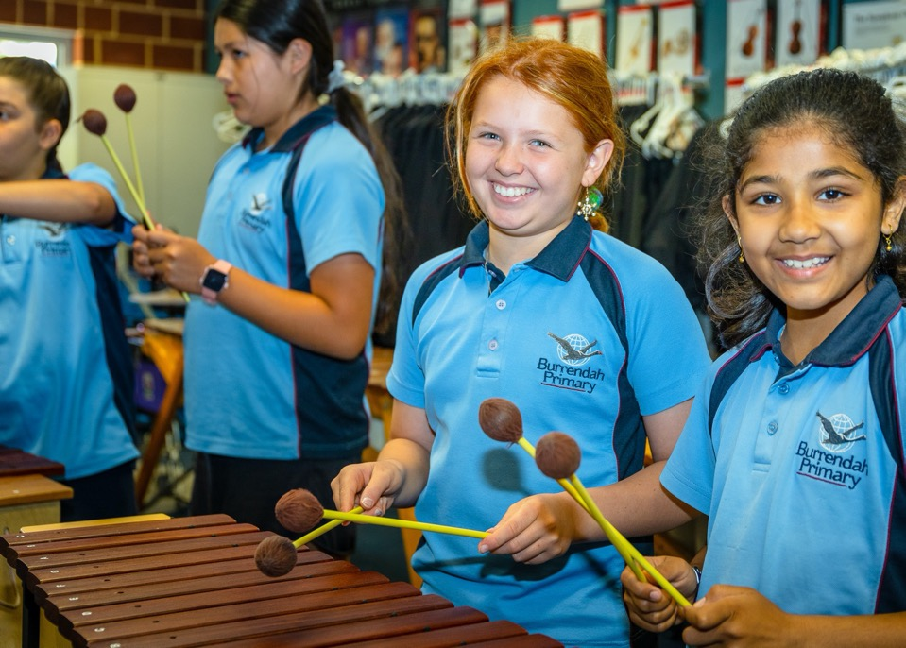
The Arts-Music
Burrendah Primary School has a robust music program directed by a music specialist. Students from Year 1-6 participate in this program as part of The Arts curriculum. Students in Year 3-Year 6 learn the recorder as part of the classroom music program, consolidating student musical literacy, performing music created by past composers and creating their own personal compositions.
At Burrendah Primary School, the following instrumental music groups operated each week:
Junior Choir comprising of 57 students from Year 1-Year 3 rehearsing on Wednesday mornings before school at 7:45am
Senior Choir comprising of 65 students from Year 4- Year 6 rehearsing on Tuesday mornings before school at 7:45am
Wind Band comprising of 21 students from Year 5 & Year 6 rehearsing on Monday afternoons from 3:15pm-4:15pm
Instrumental Music School Services (IMSS) String Orchestra comprising of 29 students from Year 4, 5 & 6 rehearsing on Thursday mornings before school at 7:30am
Chamber Strings Ensemble comprising of 18 students from Year 6 rehearsing on Monday mornings before school at 7:45am
Recorder Ensemble comprising of 11 students from Year 3- Year 6 rehearsing on Tuesday afternoons from 3:00pm-3:45pm
The IMSS programme at Burrendah Primary School offers a comprehensive instrumental selection of violin, viola, cello, double bass, guitar, flute, clarinet, trumpet, trombone and percussion. This is the largest variety of instruments that the IMSS offers at any one primary school. There are 88 students learning an instrument through our IMSS program.

Slide 19
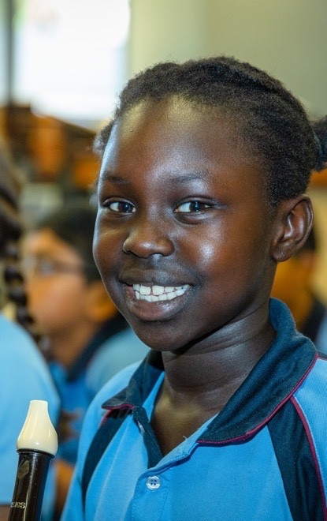
The Arts-Music – cont.
Our Choirs and Ensembles have enjoyed a high profile in the school community performing regularly at school assemblies such as ANZAC Day Ceremony, Harmony Day Assembly, Remembrance Day Ceremony, our end of year Music Concert and an IMSS Musical Soiree. The Chamber Strings ensemble also performed publicly for the first time at the WAGSMS (the West Australian Government Schools Music Society) Concert Series at the Crown Theatre, showcasing one of our outstanding students in this ensemble as a violin soloist. Our IMSS String Orchestra performed at the WA Orchestra and Band Festival 2021 and received an “Excellent” in Division “String Orchestra B.” This was an extremely admirable result in a division higher than most other primary schools had entered. The Senior Choir performed once again in the Massed Choir Festival (MCF) at the Perth Concert Hall. In 2021, two Burrendah PS students were successfully chosen from hundreds of students across numerous schools to represent our school as a soloist and a compere at the MCF.
In Term 4, the Brass Quintet from the West Australian Symphony Orchestra (WASO) visited Burrendah PS and performed a magnificent free concert for the Pre-Primary – Year 4 students in the Undercover Area. The repertoire they played was relevant, contemporary and exciting! This performance displayed brass instruments at their finest and was immensely enjoyed by all students and staff who attended.
On the last day of the year, senior students from WSHS performed a wide selection of Christmas Carols for our students and staff as a fun interactive in-school activity. All students learnt two carols to sing along with the high school band. This is the third year that the WSHS students have performed for our students. Such events help to promote the strong relationship between our two schools and demonstrates the excellent performance standard achievable by high school students. It has been a very popular and enjoyable festive activity for the last day of the year. Mr Will Heron, joined the WSHS band and sang several carols. The students and staff were thrilled to see one of their classroom teachers up on stage performing.

Slide 20
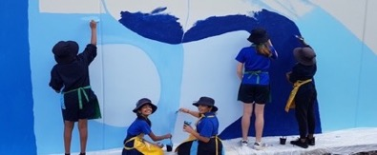
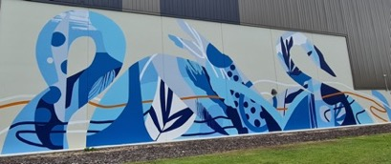
The Arts-Visual Arts
Students from Year 2 to Year 6 engaged in the 2021 Visual Arts program, which includes drawing, painting, printing, collage, sculpture, ceramics and fibre/textiles, as part of The Arts curriculum. Throughout the year, student artwork was displayed regularly in the school hall, School Reception, Classrooms and Library.
Our Year 6 students participated in a series of exciting workshops for a public art project involving professional mural artist Chris Nixon, and the newly developed Willetton Sports Precinct on Burrendah Boulevard. The ideas they created during the workshops informed a large-scale public mural design that Chris created for the precinct.
The students had the amazing opportunity to help Chris paint the mural. It was fantastic for our Year 6’s to have creative input in a facility that is extensively used by our students, families and wider public. It allowed them to engage with a professional artist and to participate in and understand real world art and design processes. The process of the students designing and creating artworks during the workshops was documented and filmed by a professional videographer.
In Term 3, 15 students from Year 5 and 6 were selected to participate in the public art project Story Threads - Connecting Cultures to Country. The students engaged in a series of workshops run by Sister Kate's artist Alta Winmar. Sister Kate's is an Aboriginal Not-for-Profit, Charitable Status Stolen Generations organisation, who deliver a wide range of cultural healing programs to heal, empower and develop leadership in Sister Kate's Home Kids, their families, and the wider community.
The public art project involved designing a mural for two colourful doors to be installed in the City's new intercultural centre located in Bentley, the student designs were incorporated into the final mural created by Aunty Alta.
In celebration of International Youth Day in Term 3, a select body of student work was exhibited at Southlands Shopping Centre. The exhibition included drawings, paintings, and mixed media artworks. The exhibition was well received by students, parents, staff and the wider community.
In Term 4, all students participating in the Art Program exhibited ceramic artworks as part of the end of Year Awards Ceremonies, including: Pinch Pot Wild Things, Slab Pets, Animal Mugs, Coil Pots and Self Portrait Busts.

Slide 21
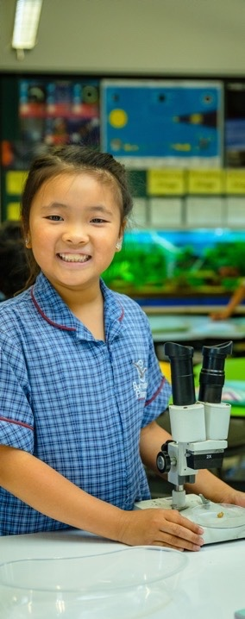
Science
The focus for science in 2021 has been on investigating procedures in the four substrands of Earth and Space, Life and Living, Chemical Sciences and Physical Sciences. Learning opportunities are provided to foster Collaboration, Character, Citizenship, Communication, Critical and Creative Thinking - Global Competencies.
One aim of Science is to increase capacity and confidence in the use of ICT. iPads, Smart board and digital photography are excellent tools for recording that have enhanced student confidence and ability to use digital technologies. 3D printers are incorporated into senior student lessons to give them experience using 3D print programs and allows them to learn how to use a 3D printer.
Extension opportunities are provided to enhance engagement in Science for highly motivated students. Through involvement with Scientists in Schools, groups of senior students were also given opportunity to work with a semi - retired physicist. Some students learned how to use an advanced animation and 3D print program while others were given opportunity to learn micro processing. The groups worked together to construct a working machine that sorted coloured marbles and spoke using recorded student voices. Several senior classes also learned the skill of soldering.
This year we continued to take part in the Synergy Solar car competition. Our team had great success at the regional final and progressed to the state final at Optus Stadium. This was also our inaugural year for the international FIRST Lego League (FLL) involvement. FLL WA was named the Chevron Science Engagement Initiative of the Year in the 2021 Premier’s Science Awards. Senior students worked with a dedicated team of volunteer high students from Willetton Senior High School, All Saints College and Lynwood Senior High School in collaboration with Curtin University. Students worked two afternoons a week after school for Terms 3 and 4 to learn how to design and program Lego robots to perform designated challenge missions and to work in teams to research and provide a solution for a real-life problem (The theme for this year was cargo). At the regional final, competing against 40 other schools – our teams had to present their ideas to a panel of judges and justify their solutions. They also had time trials for their robots to accurately complete as many of the missions as possible. One of our teams performed with the highest score for robot design and missions, therefore qualifying for the state final at Curtin University against teams from around the state. The whole semester long experience was an amazing and unique journey for all involved.

Slide 22
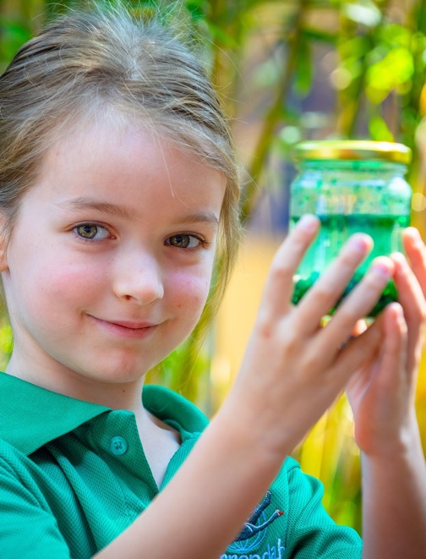
Science – cont.
Our chickens have continued to provide learning opportunities for all students and involvement of parents caring for chickens on weekends and during holidays. The garden club provides opportunity for students to grow edible crops and gain an understanding of food production. Keeping compost tumblers and worm farms demonstrate the value of recycling and reusing. We have a dedicated group of self-motivated students who run a Waste Warrior group encouraging other students to maintain tidy school grounds and use food scraps for our chickens, worm farms and compost. Despite COVID 19 restrictions we were once again able to provide a new and exciting interactive Forensic Science incursion for students.
In 2021 data was collected through Progressive Achievement Testing (PAT – Science). Data from the testing carried out in Term 4 is shown in the graphs on the following pages.
Results show the Stanines (a ranking that divides the total distribution of students into 9 categories with 5 being the midpoint). Stanines from Year 3 to Year 6 show that from the 415 students tested, 11% of students were below average (Stanines 1-3), 53% of students were average (Stanine 4-6) and 36% were above average (Stanines 7 -9).
Comparing 2017, 2018, 2019, 2020 and 2021 we see similar overall results with a continued trend of less students in stanines 1 -3 , more students moving into stanines 5 – 6 and stable numbers of students with stanines 7 - 9.
As this is a written test, students with poor literacy skills may not score results that are a true indication of their science knowledge and understanding.

Slide 23
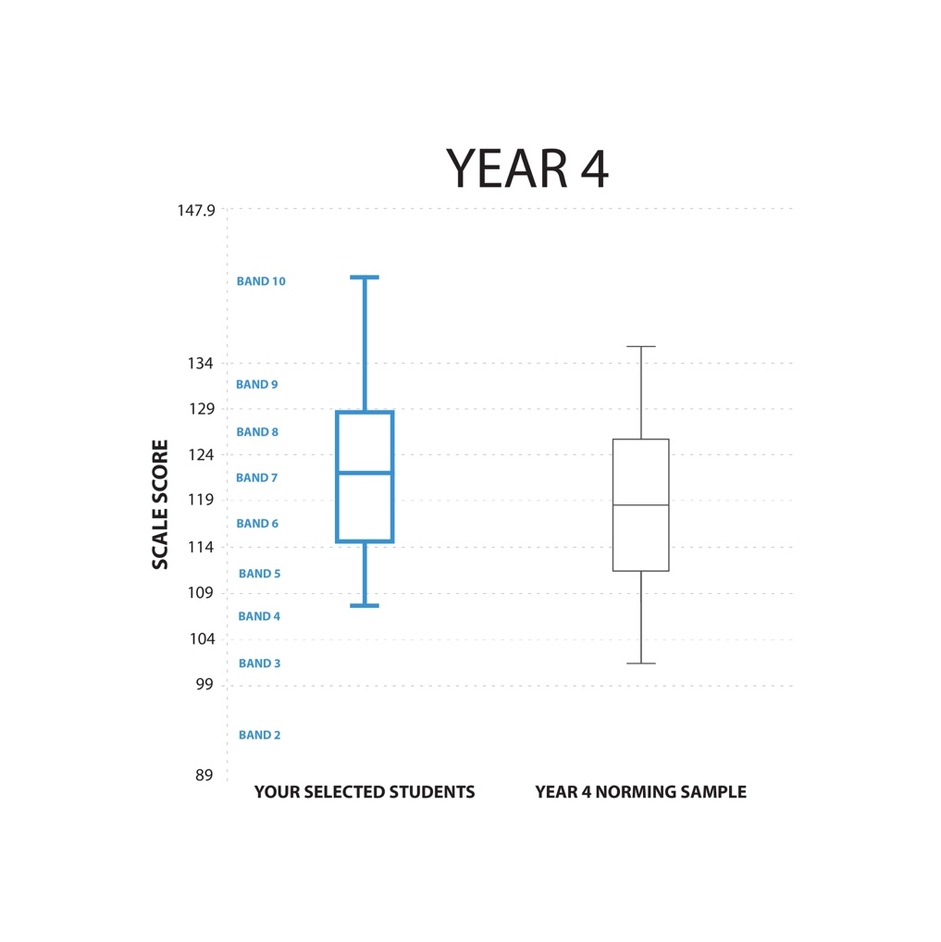
Science – cont.
When comparing our results with other schools that have used the PAT-Science, Burrendah is achieving pleasing results across all Year levels 3- 6, especially the Year 6 group of students. See comparisons below:
PAT Science / Norm Reference Report
The horizontal line inside the box shows the average. The very top horizontal line outside the box shows the highest band result. The very bottom horizontal line outside the box shows the lowest band result for the year level.

Slide 24
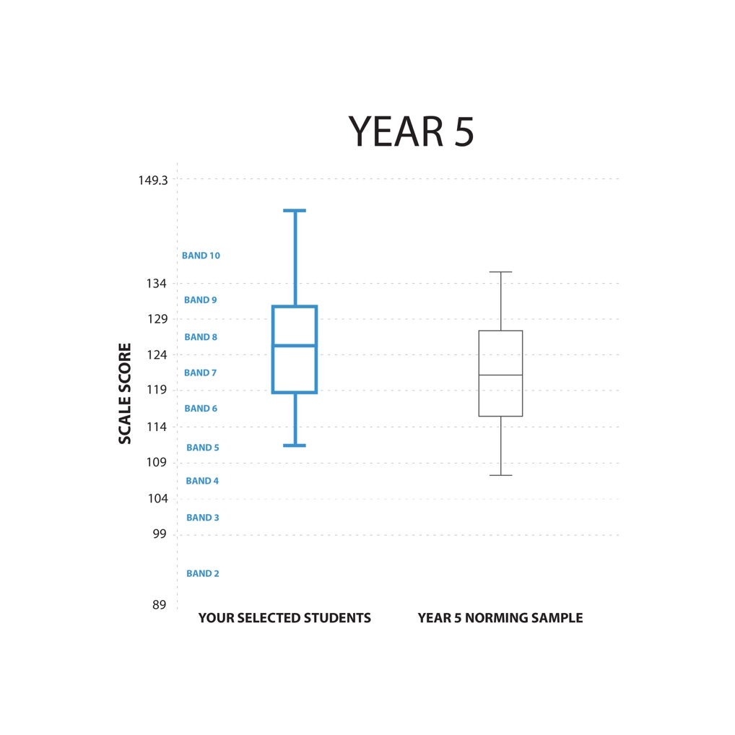
Science – cont.
PAT Science / Norm Reference Report
The horizontal line inside the box shows the average. The very top horizontal line outside the box shows the highest band result. The very bottom horizontal line outside the box shows the lowest band result for the year level.

Slide 25
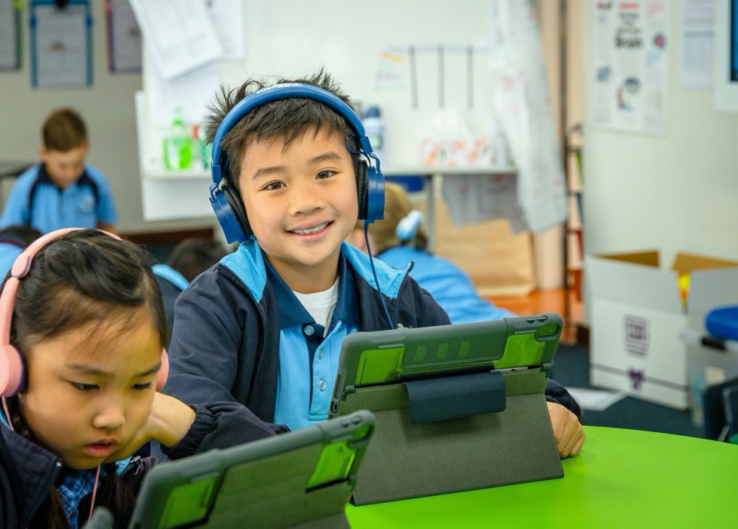
Students at Educational Risk (SAER)
During 2021 the SAER Team introduced regular Special Needs Support meetings for all Special Needs and Mainstream Education Assistants. Meeting content covered a variety of professional learning topics which were generated from the education assistants. The Positive Partnership Leader and the Autism Coach lead these information sessions.
In 2022 the SAER Team will increase membership to include a Special Needs Education assistant and the Gifted and Talented Leader. This team will work with teaching staff who have children at educational risk to support and provide strategies for individual students.
Year level transition for SAER students in preparation for the following year were completed in Term 4, Week 9 to ensure a smooth transition for these cited students for the beginning of the 2022 school year.
Data provided from a wide suite of assessments has continued to be used to identify students who are requiring Literacy Support which has continued to be provided by a Literacy Support team. This program will operate three (3) days per week in 2022. A2O and Multi Lit programs will continue to support students in Year 2 to Year 5.
School Psychologist allocation has been maintained due to ongoing needs of identified students across the school requiring access to this vital service.

Slide 26
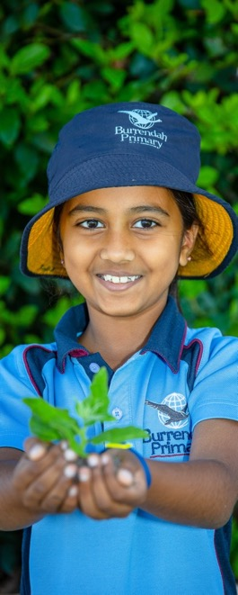
Gifted and Talented
Gifted & Talented Students demonstrate an aptitude for Critical and Creative Thinking. These students learn concepts quickly and their learning needs are met through ongoing extension and enrichment through acceleration of the curriculum.
A School Business Plan (2019-2021) focus was on developing Gifted and Talented programs within the school. Identified Gifted & Talented Year 5 students took part in a withdrawal specialist program in 2021, known as the Burrendah's Rigorous Academic Classroom Extension (BRACE) Program. The BRACE Program develops student's understandings of what critical and creative thinking is and provides students with the tools and strategies to develop these higher order thinking skills.
BRACE provides opportunities for students to develop autonomy by means of an in-depth investigation and showcase. The first part of the course, students practised higher order thinking skills; such as, Blooms Questioning, 6 Thinking Hats, Decision Making Matrix, and problem solving; applying these skills to identify themselves as learners. This set their personal growth in motion, enhanced by collaborating and communicating with their like-minded peers.
The second part of the course was known as 'Night of the Inventions'. Students applied the tools and strategies they had learned in the first
part of the course by selecting an interest-based invention using STEM as their framework.
Students embarked on an in-depth investigation of their chosen invention. They identified, explored and organised their ideas using a Timeline and Mind Map. Ideas, possibilities and actions were generated through a display of a Dinner Party and a creative Invent-o-Riddle. Thinking was reflected and evaluated using the 6 Thinking Hats as a framework. This learning was displayed on a Learning Centre, complete with souvenirs, such as, fridge magnets and bookmarks. On the night itself, students dressed as the inventor of their invention and provided higher order questions for their audience to actively engage with the presenters.
Feedback was sourced from community members who attended the showcase and supported the students throughout the BRACE Program. The recommendation was for the BRACE program to continue due to students being challenged to reach their potential using higher order thinking.
Assessment and reporting is aligned to the Critical and Creative Thinking General Capabilities in the Western Australian Curriculum. All BRACE students received a report and certificate to acknowledge their progress and participation in this Gifted and Talented program.

Slide 27
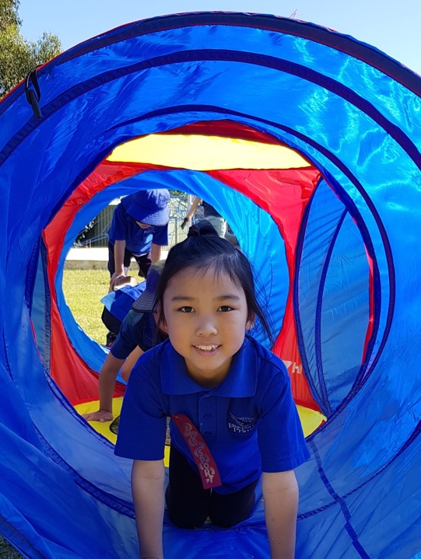
Junior Physical Education
The goal of the Junior Physical Education Program is to strive for all Burrendah Primary School students to become competent in the 22 fundamental movement skills by the end of Year 3. In the subsequent years of schooling (Year 1 and 2), the PE program is geared towards the consolidation of the key skills taught in the Foundation and Pre-Primary years of schooling.
The Junior Physical Education program in 2021 saw the continuation of a modified Perceptual Motor Program (PMP) for all Pre-Primary students. The program explored a range of fundamental movement skills such as running, jumping, balancing, climbing, rolling, throwing and catching. The success of the program was reliant upon the assistance of Year 4 students mentoring the Pre-Primary students.
The timetabled 15-minute block of Daily Fitness, in addition to 55 minutes of Physical Education, each week has enormously benefitted the continual improvement of these core skills in our Year 1 and 2 students. There was also a particular focus on building the overall cardiovascular fitness of the students by incorporating the Beep test and Endurance running into the PE and Daily Fitness program.
Junior Physical Education lessons included an explicit teaching approach using the Playing with Purpose and Games Sense to Sports Literacy Pedagogy. Body Management, Locomotor and Object Control skills were the key focus areas in the Program.

Slide 28
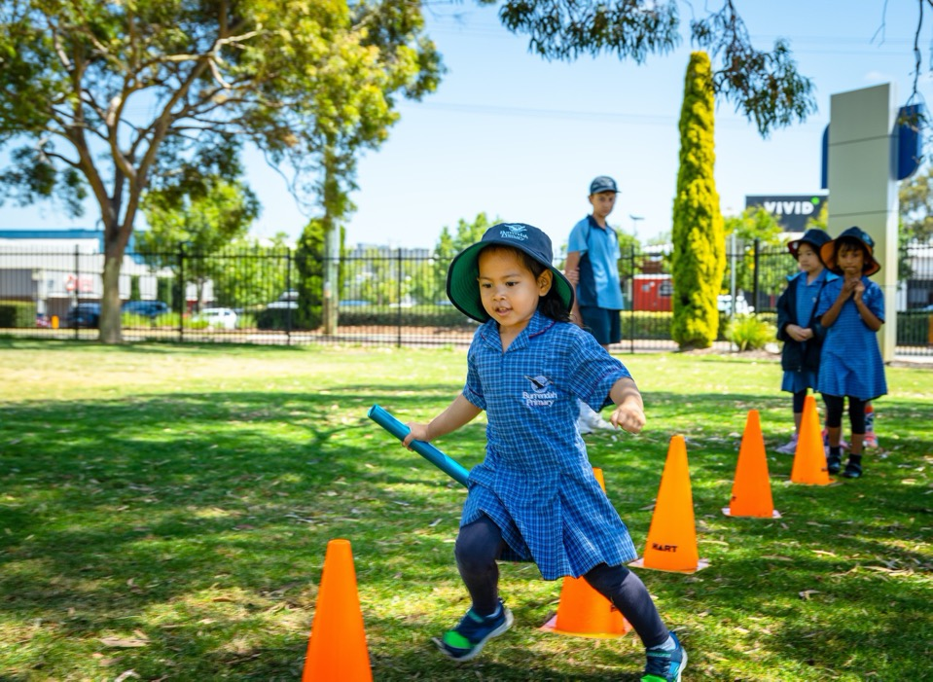
Junior Physical Education Highlights 2021
The Junior Physical Education program was again a successful recipient of the Sporting Schools Grants, which continued to expose students to a wide variety of sports this year, which included Volleyball, Tennis, Hockey and Tee-ball.
Athletics season was again a highlight in Term 3.
The support of the wider school community and Burrendah Primary School Year 6 students helping on the day continues to be extremely valuable and welcomed.
NAIDOC Week was the celebration of Aboriginal and Torres Strait Islander cultures. Students played games and participated in various activities that extended across warm-ups, strengthening, running, throwing, catching and tracking.
Continuation of the Year 11 Community Links Program and the Year 12 Work Experience program, where WSHS students worked with Burrendah PS students assisting in skill development activities and umpiring modified games.
Your Move Canning, is a program aimed at helping students to get active by walking, scooting and riding to school. Burrendah PS was a recipient of a grant from the Department of Transport, which enabled Year 2 students to participate in a series of bike education lessons provided by People on Bicycles.
28

Slide 29
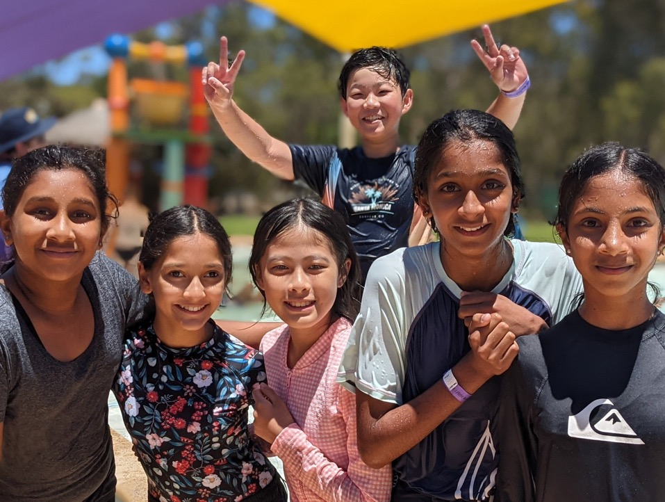
Senior Physical Education
The Senior Physical Education Program provides all students in Years 3, 4, 5 and 6 the opportunity to develop greater proficiency of movement across a range of skills and apply them with confidence and competence in a variety of physical activities. They combine skills to create movement patterns and apply strategies to achieve outcomes that broaden their knowledge of the benefits of physical activity in relation to health and well-being. The students are taught to include others and how to recognise the consequences of personal and team actions. They are encouraged to be more physically active and develop their understanding of fitness and goal setting.
Senior students were able to start the year facing many challenges during the Year Six Sport and Recreation Camp at Point Walter. They had to build a raft, from planks of wood, ropes and plastic containers, that would float on the river and support their team of eight people, while successfully navigating a racecourse with paddles, against the opposing team. The students were asked to take a leap of faith off the flying fox tower, climb to the top of a very high frame on a log and chain structure, and then let go, to be lowered to the ground in their harness. They fired arrows, paddled canoes, flew kites and worked together to solve problems in the pool, on the orienteering course and team puzzles. It provided the opportunity for this cohort to develop leadership and trust, and collectively take responsibility for setting team goals and working together to achieve them. The Camp provided experiences that helped to prepare our senior students for the additional responsibilities they face in their final year of primary school.
29

Slide 30
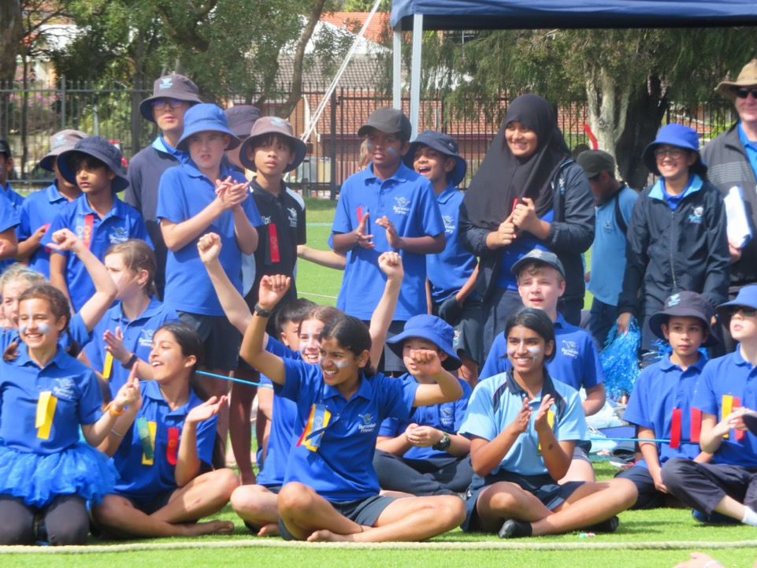
Senior Physical Education – cont.
The Senior Interschool Sport Program involves over 200 students learning a nominated sport over two terms culminating in the selection of teams to represent Burrendah Primary School at regional carnivals. The skills and strategies required to compete in the sports are explicitly taught in the Specialist Physical Education lessons. This year our girls cricket team qualified to compete in the state finals. An amazing experience that allowed our team to apply their skills at a higher level. The soccer and league tag teams also won their carnivals. Our teams were complimented on their great attitude and sense of fair play, by sporting officials and community members.
The Faction Carnival Program provides the opportunity for students to participate in swimming, cross-country, athletics and dance. They develop a sense of school pride as they perform in carnivals and performances with the support of their peers. Parents are encouraged to be involved and grow our school community. The program has supported the students to maintain their exercise levels, become more resilient in adapting to change and stay healthy, energised and safe.
Pre-primary to Year 6 students participated in the Dance program EduDance during Term 4 which culminated in two evening concerts for families to enjoy.
30

Slide 31
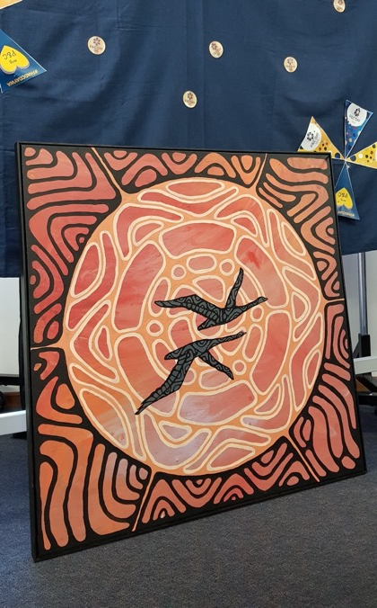
Humanities and Social Science (HASS)
The wide range of different cultures at Burrendah Primary School enhances students’ understanding of other people’s viewpoints and backgrounds. Collaboration with the EAL/D team has provided teachers and students the resources and opportunities to engage in festivals and celebrations of all cultures, and to understand how people from many different backgrounds and areas of the world have contributed to Australian History. In 2021 the Harmony Day Assembly enabled many students to showcase their cultural identity and the NAIDOC Assembly reinforced the concepts of reconciliation and healing through drama and art. Children from all ages and ethnic backgrounds were involved in producing the artwork and performing in the items for both events and the whole school participated in singing in Noongar language. Continued collaboration with the Walley family resulted in the presentation of an original artwork for Burrendah Primary School by Dr Walley OAM and his son, Alton, at the NAIDOC Assembly. The artwork is now on display in Reception.
The HASS Operational Plan was updated and teachers are using HASS content as a platform for developing the skills of questioning, researching, analysing, evaluating, communicating and reflecting on concepts in History, Geography, Civics and Citizenship (Years 3-6), and Economics and Business (Years 3-6). The introduction of the BYOD Programme in Year 4 and the purchase of additional iPads for teaching blocks has enabled teachers to integrate ICT Capabilities into HASS lessons. Teachers are using online resources such as Inquisitive to develop rich learning tasks that foster inquiry learning and collaborative skills.
There is a continued focus on embedding the Aboriginal Cultural Standards Framework into teaching and learning across all areas of the curriculum. We are working towards becoming a Culturally Responsive School as defined by the indicators on the continuum in the Framework. Staff have expressed a need for further professional learning in this area to develop their skills in integrating Aboriginal perspective in their lessons. Several staff have enrolled in a Noongar language course offered by Curtin University.
31

Slide 32
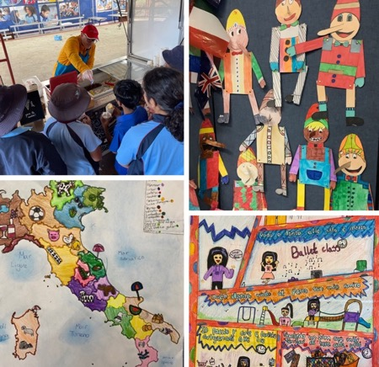
Languages (Italian)
Students in Years 3-Year 6 enjoyed a range of engaging and interactive learning experiences during their weekly Italian lessons. For the first time, all students studied under the now fully-implemented Western Australian Curriculum for Languages. Students in Year 4 also benefited from their participation in the BYOD program with their iPads affording them the opportunity to explore and display their Italian skills in new and dynamic ways.
A brief summary of content covered in each year level is as follows:
Year 3 - Greetings, colours, numbers, family members, animals, feelings & adjectives
Year 4 - Days of the week, telling the time, school life (subjects, materials, people)
Year 5 – Rooms of the house, places in neighbourhood, Italian architecture
Year 6 – Grammar (verbs, articles, plurals), free time and hobbies, party invitations
For the first time, Burrendah Primary School entered the Western Australian Association of Teachers of Italian (WAATI) Fammi un Poster competition with Year 3 and Year 4 students being commended for the creativity and grammatical accuracy of their entries.
Special celebrations such as Pasqua (Easter) and Natale (Christmas) were marked by Year 3 students making colombe (doves) and La Befana crafts.
Students learned about the rich history of Italian architecture and art and experimented with making Pinocchio puppets and Modigliani-style portraits (Year 3), Mona Lisa portraits (Year 4), a detailed Italian piazza (Year 5), colourful Carnevale posters (Year 6)….and the whole school enjoyed the visit from native Italian speaker, Tino and his wonderful gelato van!
32

Slide 33
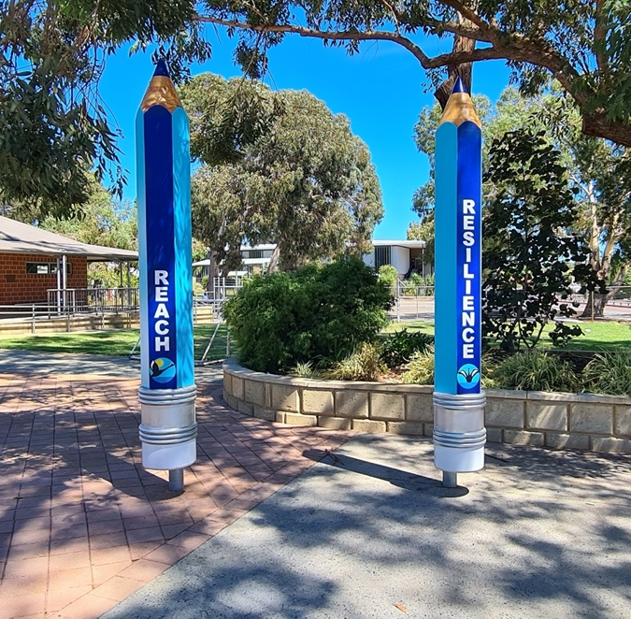
Positive Behaviour Support (PBS)
This is the fourth year into our five-year Positive Behaviour Support Plan. We have continued our focus on branding and implemented the PBS curriculum into every classroom. The School Front Entrance now includes the 4Rs displayed by four large pencils. Curriculum lessons each week explicitly teach students identified Behaviour Expectations. This is complimented each day through student leader information on the PA, classroom and wet area visuals, Expectations included on Connect to parents each week as well as in the online newsletter and the use of our new GROW Awards. Lunchtime Clubs were held for Numero, chess, crochet and gardening, providing extra-curricular activities students could choose to participate in, to foster mental health and well-being.
The PBS committee investigated alternative forms of acknowledgement and rewards in 2021. The result of these is our new GROW Awards. GROW Awards link to the school’s 4R’s, Respect, Responsibility, Resilience and Reach. They are offered weekly across the school by classroom and specialist teachers to students displaying the Expectations. Every award adds to the Faction Tally. Students can view results from the PBS Thermometer displayed at the School Hall Entrance. Student Leaders provide the factions running total in their weekly whole school Webex. Students each term aim to be the leading faction to claim the End of Term Faction Reward. Pleasingly, an outside reviewer found when surveying staff and students, implementation for Reward Systems for PBS had increased from 66% in 2019 to 100% in 2021.
REACH
RESILIENCE
RESPECT
RESPONSIBILITY
33

Slide 34
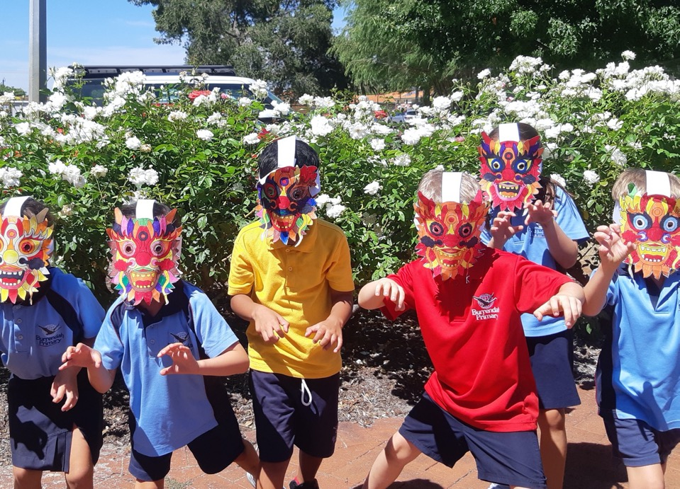
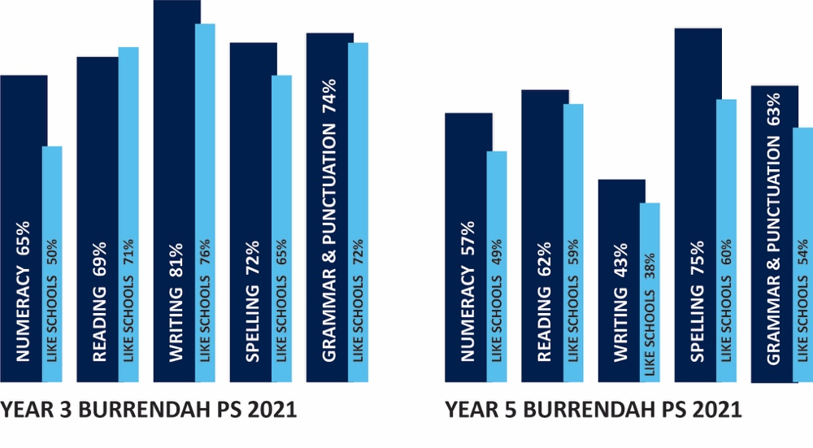
School and Student Achievement
NAPLAN – WA School Comparison
When comparing like schools in WA, our academic results, as in past years, remained consistently high. We achieved our target of having a higher percentage of students achieving in the top two bands for all areas bar Reading in Year 3 and in all areas in Year 5 as shown in the graphs below.
A continued focus is to attain more areas in the highest possible level of higher progress and high achievement for
Year 3 to Year 5. It was pleasing to see this was achieved for Grammar and Punctuation.
34

Slide 35
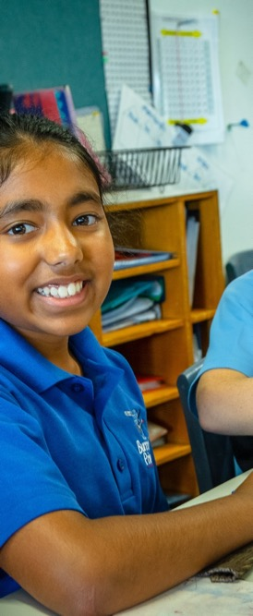
NAPLAN – My Schools Comparison
We use two types of data sets when comparing NAPLAN. These are: similar schools using an Australian school context such as My Schools Website and similar schools using a Western Australian (WA) context.
My School Website school's performance is compared to the performance of all students with a similar background across Australia. Students have a similar background as determined by parental occupation and education, Indigeneity and geographic location.
My School Website school's performance is compared to the performance of all students with a similar background across Australia. Students have a similar background as determined by parental occupation and education, Indigeneity and geographic location. In 2021 Burrendah Primary School average for both Year 3 and Year 5, when compared to students with a similar background, ranges from close to, to ‘well above’, with the majority of results in the ‘above’ category.
The percentage of Year 5 students who achieved above average progress, compared to students of a similar background and who had the same starting score on their previous NAPLAN test in Year 3 continue to be within the expected range.
Increasing the number of learning areas in the highest possible level of higher progress and high achievement for Year 3 to Year 5 remains a focus. It was pleasing to see this was achieved for Grammar and Punctuation.
BURRENDAH PRIMARY SCHOOL 2021 NAPLAN SCHOOL AVERAGE WHEN COMPARED TO STUDENTS WITH SIMILAR BACKGROUND:
 | Reading | Writing | Spelling | Grammar | Numeracy
Year 3 | 477 | 463 | 474 | 487 | 453
Year 5 | 543 | 516 | 559 | 559 | 534
Interpreting the table: n = Well above average n = Above average n = Close to average

Slide 36
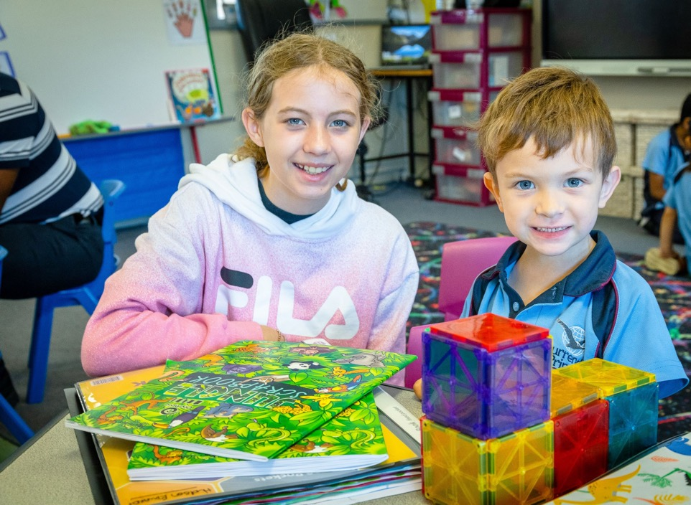
National Quality Standard (NQS)
In Western Australia, The National Quality Standard (NQS) sets a high national benchmark for early childhood education. The NQS includes 7 quality areas that are important outcomes for children and provides an assessment framework for Kindergarten to Year 2.
In 2021, a yearly review of all the standards was conducted which included not only the early year’s perspective, but also invited feedback from the whole school (from Kindergarten to Year 6). The NQS committee grew in staff representation and as a committee, a continuous review cycle of each quality standard was undertaken. Each standard was scrutinised to identify areas which we continue to demonstrate consistent practice in, areas which are being maintained and also identified focus areas to continue to strengthen. It was identified that as a school, Standard 3: Physical Environment is an area of focus. With this in mind, a P & C Nature Playground Committee was established in 2021, which included school community representation. The committee has been instrumental in the design and concept vision for a new nature playground space which will be created in stages. The concept of the nature playground space includes an open free flowing design which starts at the back of Room 12 (Year 4 area) and will flow through to the early childhood space, into the Kindergarten and Pre-primary area, over a series of stages. An overall concept design and scope of works were drawn up with a view to stage one of the concept commencing in 2022.
As a school who had successfully implemented the National Quality Standards and are consistently attaining all seven standards, we were invited by the Department of Education to be part of a case study to be included in a resource that will be published and distributed to schools which provides examples of practice from teachers working in Kindergarten to Year Two across Western Australia, showcasing how they meet the seven Quality Areas of the NQS.
The end of 2021 also saw significant funding put towards upgrading a Kindergarten classroom which included new flooring, classroom mat, cupboards, storage and a kitchen. The resource sheds were further organised. New quality play-based resources are now systematically stored in a centralised location, for all year levels across the school to access. Flexible furniture was purchased for a further three early childhood classrooms.
36

Slide 37
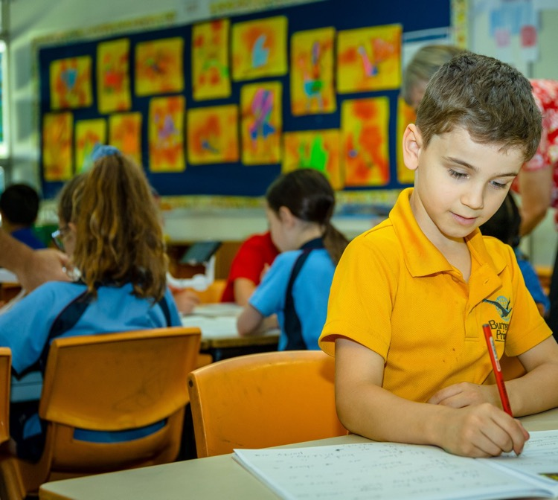
On Entry Testing
In 2021 all Pre-primary and Year 1 students were assessed in On Entry Literacy and Numeracy during Weeks 4 – 7 in Term 1. On Entry is a mandatory assessment for all Pre-primary students. At Burrendah Primary School all Year 1 students are assessed to ensure the development of Literacy and Numeracy can be monitored. This assessment provides each class teacher the opportunity to assess individual students on a one-to-one basis to gather information about conceptual development and understandings.
In 2021 Reading, Numeracy and Writing data was once again judged against the Public Schools Median, ICSEA (Index of Community Socio-Educational Advantage) Median and the Group Median. Speaking and Listening is analysed by progression / development points. The ICSEA decile for Burrendah places us in the highest decile 1- 2 on a scale of 1 – 10.
Results for Pre-primary indicate we are higher than the Public School mean in Numeracy and Writing. We are equal in Reading. Our aim is to be equal or higher than the ICSEA. We accomplished this for Writing.
In Year 1 we are higher than the Public School Mean in all areas. We are equal or higher to the ICSEA in Numeracy and Writing.
2021 Testing Results
Pre-primary
 | Numeracy | Reading | Writing
Burrendah Group median | 445 | 456 | 242
Public School Median | 435 | 456 | 210
ICSEA | 464 | 478 | 242
Year 1
 | Numeracy | Reading | Writing
Burrendah Group median | 550 | 530 | 507
Public School Median | 503 | 515 | 450
ICSEA | 529 | 532 | 507
37

Slide 38
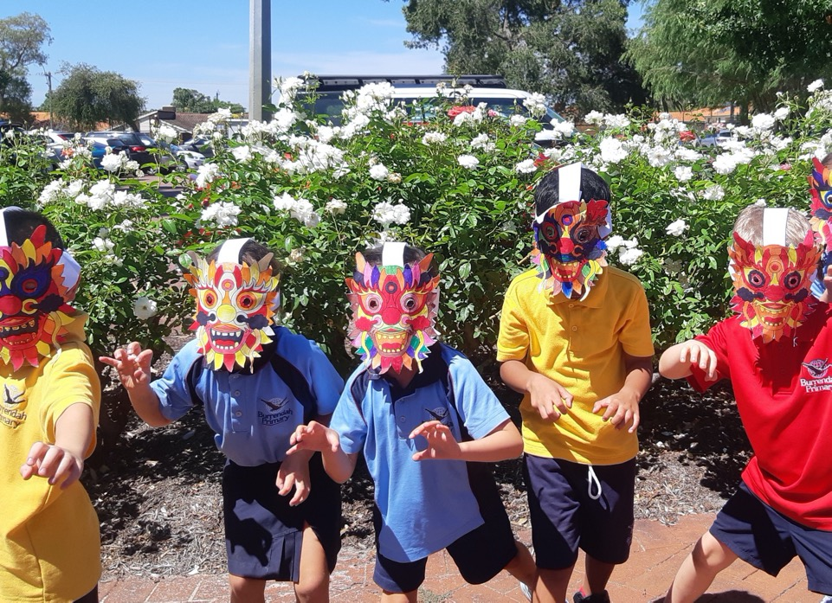
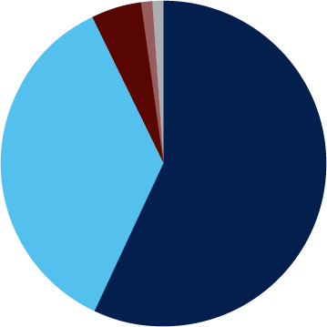
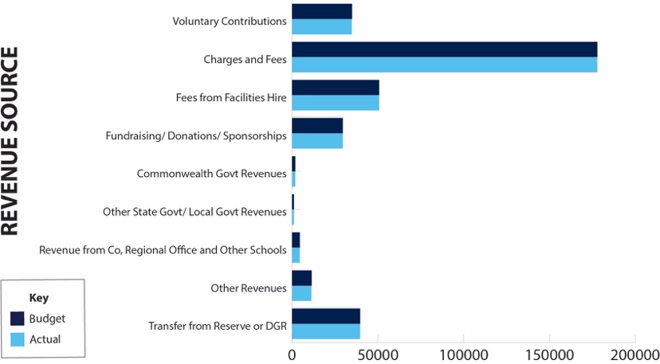
Financial Reporting at 31 December 2021
CURRENT YEAR ACTUAL CASH SOURCES
 | REVENUE - CASH |  | BUDGET | ACTUAL
1 | Voluntary Contributions |  | $ 34,944.00 | $ 34,764.00
2 | Charges and Fees |  | $ 177,854.00 | $ 177,849.98
3 | Fees from Facilities Hire |  | $ 50,695.55 | $ 50,695.46
4 | Fundraising/Donations/Sponsorships |  | $ 29,505.00 | $ 29,504.53
5 | Commonwealth Govt Revenues |  | $ 1,809.00 | $ 1,808.61
6 | Other State Govt/Local Govt Revenues |  | $ 1,000.00 | $ 1,000.00
7 | Revenue from Co, Regional Office and Other Schools |  | $ 4,395.00 | $ 4,394.96
8 | Other Revenues |  | $ 11,332.00 | $ 11,135.72
9 | Transfer from Reserve or DGR |  | $ 39,589.00 | $ 39,589.00
10 | Residential Accommodation |  | $ - | $ -
11 | Farm Revenue (Ag and Farm Schools only) |  | $ - | $ -
12 | Camp School Fees (Camp Schools only) |  | $ - | $ -
 |  | Total Locally Raised Funds | $ 351,123.55 | $ 350,742.26
 |  | Opening Balance | $ 221,564.25 | $ 221,564.25
 |  | Student Centred Funding | $ 460,759.00 | $ 460,759.22
 |  | Total Cash Funds Available | $ 1,033,446.80 | $ 1,033,065.73
 |  | Total Salary Allocation | $ 5,683,899.48 | $ 5,683,899.48
 |  | Total Funds Available | $ 6,717,346.28 | $ 6,716,965.21
57% Student Centred Funding
36% Locally Raised Funds
5% Transfers from Reserves
1% Other
1% Other Govt Grants
38

Slide 39
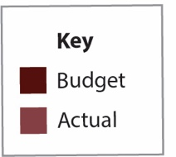
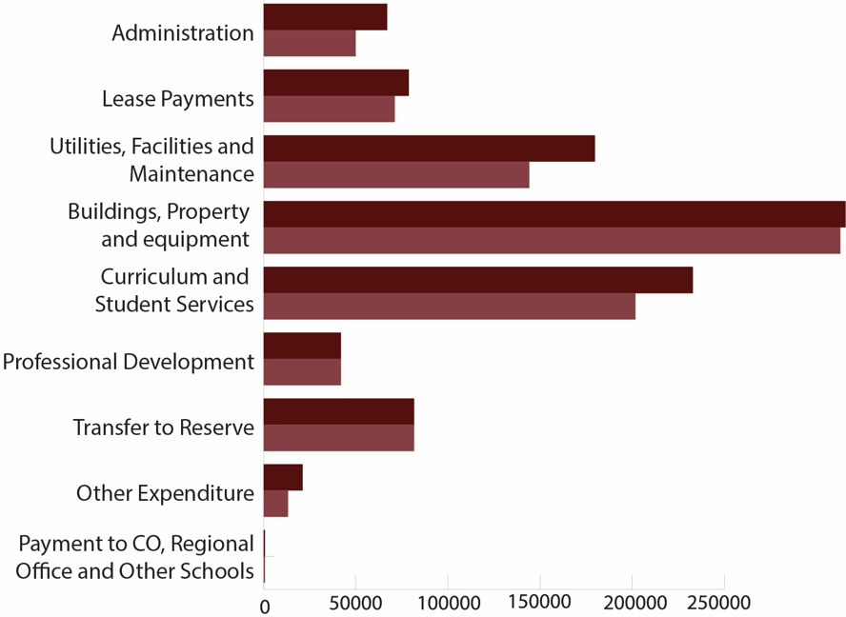
 | EXPENDITURE |  | BUDGET | ACTUAL
1 | Administration |  | $ 66,985.00 | $ 49,937.54
2 | Lease Payments |  | $ 78,818.00 | $ 71,129.69
3 | Utilities, Facilities and Maintenance |  | $ 179,810.00 | $ 144,119.01
4 | Buildings, Property and Equipment |  | $ 315,819.64 | $ 313,048.90
5 | Curriculum and Student Services |  | $ 232,946.21 | $ 201,804.53
6 | Professional Development |  | $ 41,900.00 | $ 41,900.63
7 | Transfer to Reserve |  | $ 81,638.55 | $ 81,639.00
8 | Other Expenditure |  | $ 21,107.00 | $ 13,225.78
9 | Payment to CO, Regional Office and Other Schools |  | $ 675.00 | $ 675.00
10 | Residential Operations |  | $ - | $ -
11 | Residential Boarding Fees to CO (Ag Colleges only) |  | $ - | $ -
12 | Farm Operations (Ag and Farm Schools only) |  | $ - | $ -
13 | Farm Revenue to CO (Ag and Farm Schools only) |  | $ - | $ -
14 | Camp School Fees to CO (Camp Schools only) |  | $ - | $ -
 |  | Total Goods and Services Expenditure | $ 1,019,699.40 | $ 917,480.08
 |  | Total Forecast Salary Expenditure | $ 5,415,231.00 | $ 5,415,231.00
 |  | Total Expenditure | $ 6,434,930.40 | $ 6,332,711.08
 |  | Cash Budget Variance | $ 13,747.40
CONTINGENCY REVENUE – BUDGET vs ACTUAL
39

Slide 40
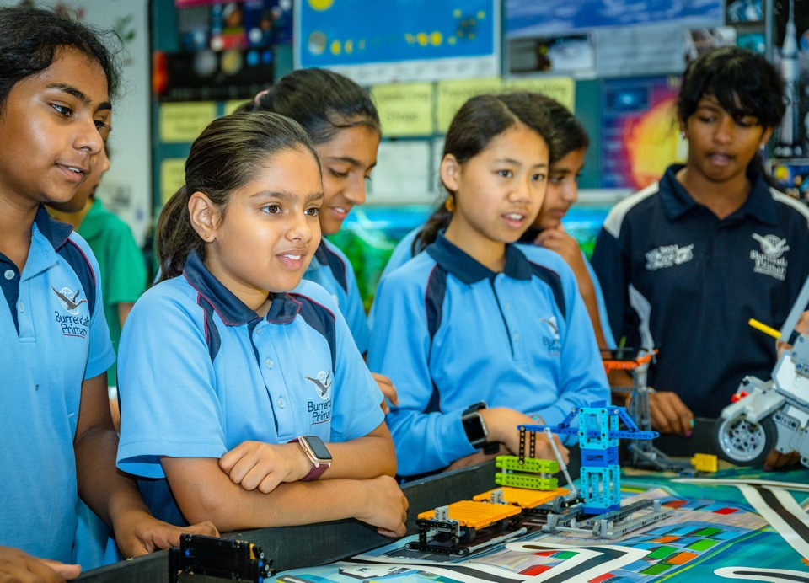
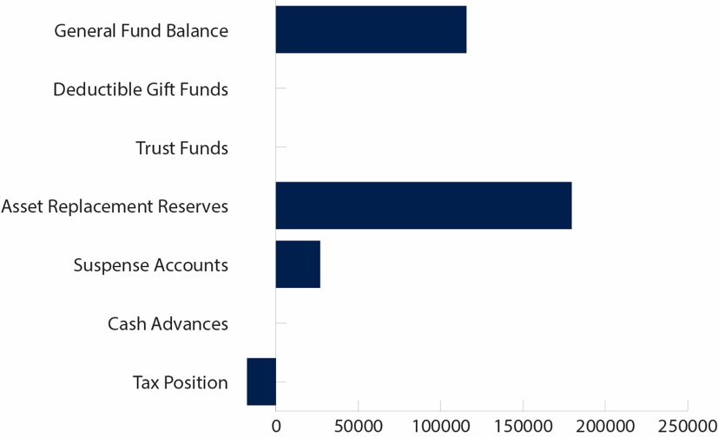
 | CASH POSITION AS AT: |  | Dec 2021
 | Bank Balance |  | $ 304, 439.50
 | MADE UP OF:
1 | General Fund Balance |  | $ 115, 585.65
2 | Deductible Gift Funds |  | $
3 | Trust Funds |  | $
4 | Asset Replacement Reserves |  | $ 179,531.85
5 | Suspense Accounts |  | $ 26,836.00
6 | Cash Advances |  | $
7 | Tax Position |  | -$ 17,514.00
 |  | Total Bank Balance | $ 304,439.50
CASH POSITION
MADE UP OF
40

Slide 41
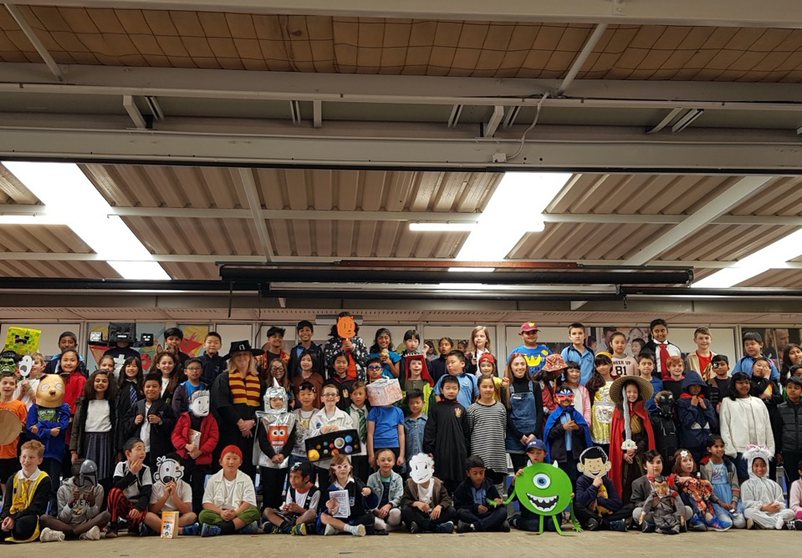
Burrendah Primary School
Castlereagh Close, Willetton WA 6155
(08) 92666200
burrendah.ps@education.wa.edu.au
www.burrendahps.wa.edu.au
41

