Slide 1
Welcome to Kindy
Room 13

Slide 2
Attendence
Monday-Thursday and odd week Wednesdays (Weeks 1,3,5,7,9)
Tuesday-Friday and even week Wednesdays (Weeks 2,4,6,8,10)
If you know your child is going to be away you can email me, email or call the office or let one of the teachers know.

Slide 3
Morning Routine
Our doors open at 8:30am every morning to encourage you to enjoy a book or puzzle with your child at the beginning of their day.
Your child may also like to take you for a walk around the classroom and this will give you opportunities to share and celebrate your child’s learning.
At 8:50am the bells will ring to signal the commencement of our mat session.

Slide 4
8:30-9:00 | Doors open- Puzzles and books
9:00-9:10 | Bells ring pack away Greetings/Songs rhymes Date and weather chart
9:10-9:30 | Mat Session Letters and Sounds
9:30-10:30 | Activities/FMS as an activity when possible
10.30-10:45 | Recess snack
10:45-11:15 | Outside play
11:15-12:00 | Revision Continue activities
12:00:12:20 | Crunch and Sip
12:20: 1:05 | Literacy-Monday/Tuesday Numeracy groups-Thursday/Friday
1:05-1:50 | Lunch
 | Outside play Pack away
2:00-2:30 | Viewing/Relaxation
2:30-2:50 | Pack bags Music and movement/News Smart board/ Review Library Monday and Tuesday
2:50-3:00 | Pack away, story/game Home

Slide 5
Literacy Learning in Kindy
Students are learning to read by:
Developing an appreciation for literature by choosing texts, holding books the right way and turning pages carefully
Developing concepts of print by knowing that print goes from left to right and top to bottom
Knowing how texts are organised
Connecting personal experiences to texts
Recalling information and sequencing simple stories
Knowing that print carries a message
Listening to texts read and talking about ideas that are represented
In Speaking and Listening students are learning to:
Speak clearly and fluently
Listen to and independently follow instructions
Answer simple questions in group situations
Participate with peers and adults in small group activities
Talk with known adults and peers about personal experiences
Listen attentively when on the mat
Students are learning to write by:
Using letters and letter approximations in writing
Practising correct pencil grip and letter formation
Using directionality e.g. top to bottom and left to right
Having a go at writing and assigning a message to written symbols
Knowing that writing carries a message
Understanding that writing and drawing are different
Students are developing Phonological Awareness by learning about:
Syllables in words
Rhyming words
The sounds letters make

Slide 6
Numeracy Learning in Kindy
Students are learning about number by:
Knowing the number names are said in sequential order
Counting using one to one correspondence
Recognising numbers 0 – 10
Practising the writing of numbers
Knowing and naming basic shapes
Sorting and classifying objects into groups
Subitizing collections to six
Drawing collections of a given size
Students are learning about measurement by:
Comparing and ordering the attributes of length, mass, capacity and area e.g. ‘heavier’, ‘lighter’, ‘tall’, ‘short’, ‘full’, ‘empty’, ‘bigger’, ‘smaller’
Using the language of measurement e.g. ‘almost’, ‘about’ and ‘between’
Using the language of time e.g. ‘lunch time’, ‘morning’, ‘after’, ‘before’
Developing an awareness of the sequence of daily routines
Students are learning about space by:
Recognising and matching basic 2D shapes in the environment
Identifying the features of basic 2D shapes
Using mathematical language of location e.g. ‘up’, ‘down’, ‘on’, ‘under’
Recognising, following and making simple patterns

Slide 7
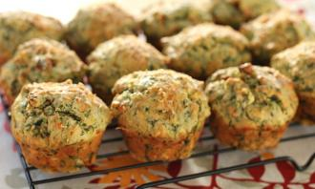
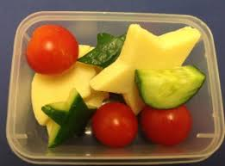
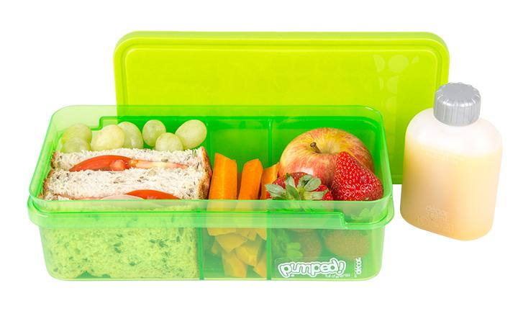
Meals
We will have 3 meal breaks during the day.
Please have only water in your child’s bottle.
Please don’t send in any products containing nuts as we have many children with nut allergies in the school.
Water bottle All day | Recess 10:30 | Crunch & Sip 12:00 | Lunch 1:05

Slide 8
Kindy Info
Writing - We use the font Victorian Modern Cursive at Burrendah- I have provided a copy of the alphabet in Victorian Modern Cursive.
We have ‘take home boxes’ in the class where we will place notes and the children’s take home work. The children will empty the box at the end of the day into their bag.
Children may come home with a bag of ‘drawing/writing’ this will be independent activities and not looked at by teachers.
Work sample files will be available thought out the year for you to look at during morning drop off.
Library- Monday or Tuesday.
You will be asked to take the washing home on a Wednesday a few times a year.
We will compile a list of this that will assist us in providing a hands-on sensory program. It would be greatly appreciated if you could make a donation to our classroom.
Birthdays – We are happy for you to bring in individual small cakes to help celebrate your child’s birthday.

Slide 9
Parent Help
Parent helpers are important and highly valued in our early childhood programs.
We will be putting parent rosters out towards the middle of this term as we feel that the children need time to develop independence and settle into Kindy routines.
We would like to encourage mums, dads and grandparents to come along on roster. To enable you to get the most out of your time with the class we would prefer no younger siblings on roster.

Slide 10
Hats
There is a NO HAT NO PLAY policy throughout the whole school so please ensure that children bring their school hats everyday

Slide 11
Change of Clothes
A change of clothes is essential for the occasional toileting accident and/or messy play or accidents.
Please ensure that this clothing remains seasonally appropriate and please label all clothing clearly.

Slide 12
Collecting Children
Children should to be dropped off and collected from Kindy by an adult.
If you need to make alternative arrangements please let one of the teachers know.
High school children are able to pick up your Kindy child.

Slide 13
Thank you
Deborah.Carey@education.wa.edu.au
Please come and chat with me any time during drop off and pick up.

